Slide 1
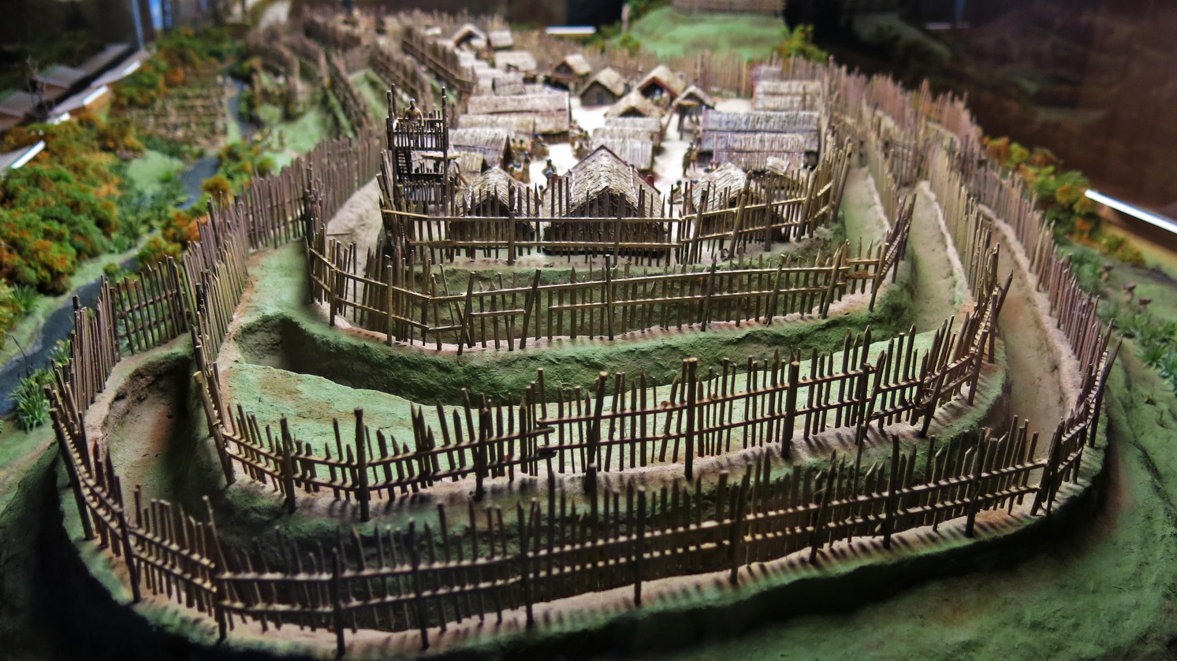
Notes:
Maori Pā
What is a pā?
Juniors: The seniors visited a pā on Mrs Brown’s farm last week and learned so much about how Māori lived in pā a long time ago
Seniors: Last week on Mrs Brown’s farm we learned so much about pā and how early Māori lived together there.
Q what do you remember about this?
Structure of pā
Food preservation on a pā
Roles and responsibilities on a pā
Differences and Similarities between responsibilities – Māori Pā and my home today (venn)

Slide 2
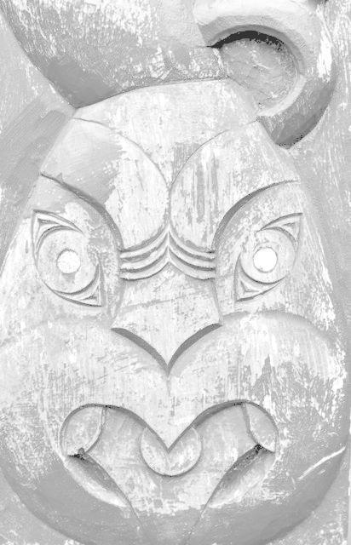
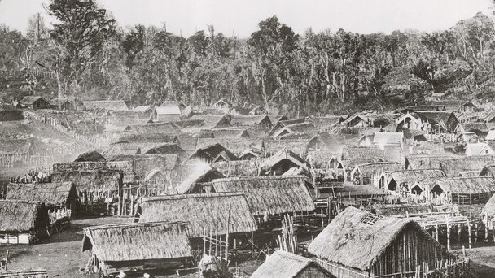
Ngatea Primary School Intentions for PLD…
The story behind our achievement data reveals to us that the way that we are teaching (pedagogy), our Māori and Pasifika needs to be evaluated and redeveloped so that our pedagogy is more culturally responsive in nature. Furthermore, we need to redevelop how we are teaching literacy and numeracy programmes and consider how these might be integrated and more context based in order to enhance the engagement of our priority learners.
Notes:
More than 6000 pa sites are known throughout NZ
Size depended on population. The majority of pa in New Zealand were built before the arrival of the European and ranged in size from tiny fortified homes to huge complexes covering many hectares. The frame of the homes were constructed from light poles packed with tightly bundled grass, wiwi - reed, or raupo.
Walls were sometimes made of tree-trunks or ferns, while roofs were thatched or covered with totara bark. Some pa had larger houses, which probably belonged to chiefs and would also serve as assembly places for the community.

Slide 3
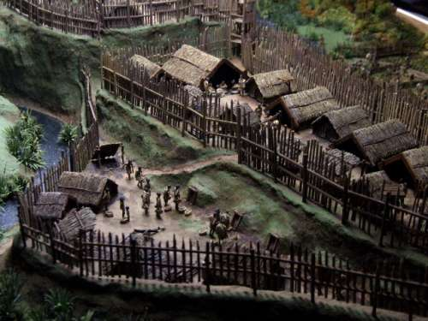
Notes:
At the time of the first fighting between Maori and British forces in the 1840s, many English people, believed that Maori were primitive savages with little knowledge of military technology or modern warfare. However, the ingeniously constructed fortified pa that British soldiers encountered left the colonial soldiers in no doubt that Maori military engineering was highly sophisticated and effective.

Slide 4
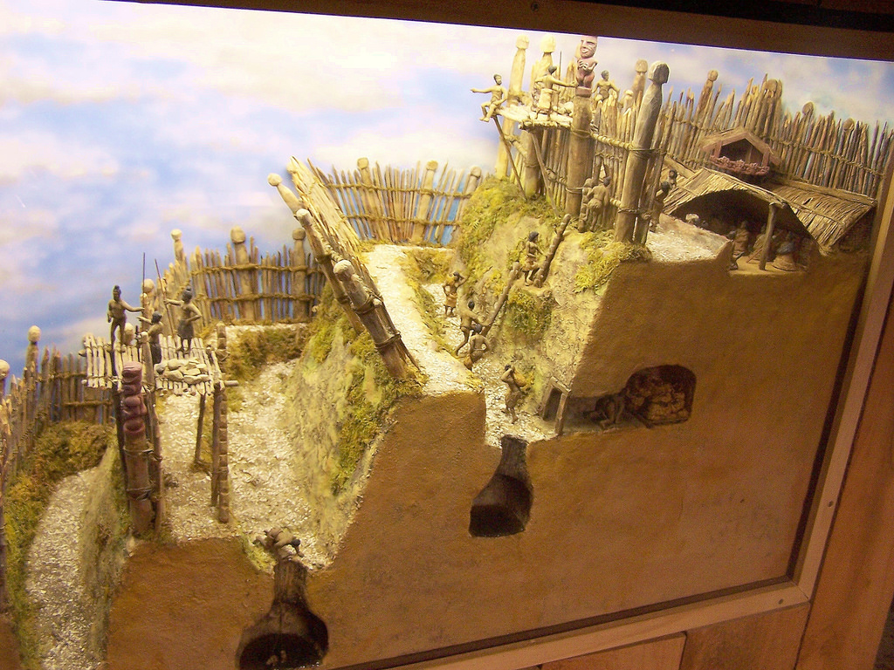
He Kōrero Whakataki - Introduction
Next
Notes:
Maori main defence in a Pā was the use of earth ramparts (or terraced hillsides), topped with stakes or wicker barriers.
Traditional pā were fortified positions designed to defend inhabitants with a mix of earthworks, palisades and excellent natural defences.
These pā were designed to defend against war parties armed with all types of weapons: short clubs of wood, bone or stone, longer wooden weapons, and spears of several different varieties.
Cleverly constructed stockades that surrounded pa enabled those inside the pa to fire outside.
Rua (underground bunkers) in the interior of the pa minimised the effects of enemy artillery fire, and cleverly placed harakeke (flax) screens outside the outer palisades (sharpened wooden stakes) absorbed enemy fire and hid damage to the main defences. 70 british soliders killed when they tried to take over Pā – very few Māori fatalities.
While the pa of the nineteenth century had impressive fortifications, there is no evidence to suggest that the earliest pa in New Zealand, dating to before 1500, had any fortifications at all.

Slide 5
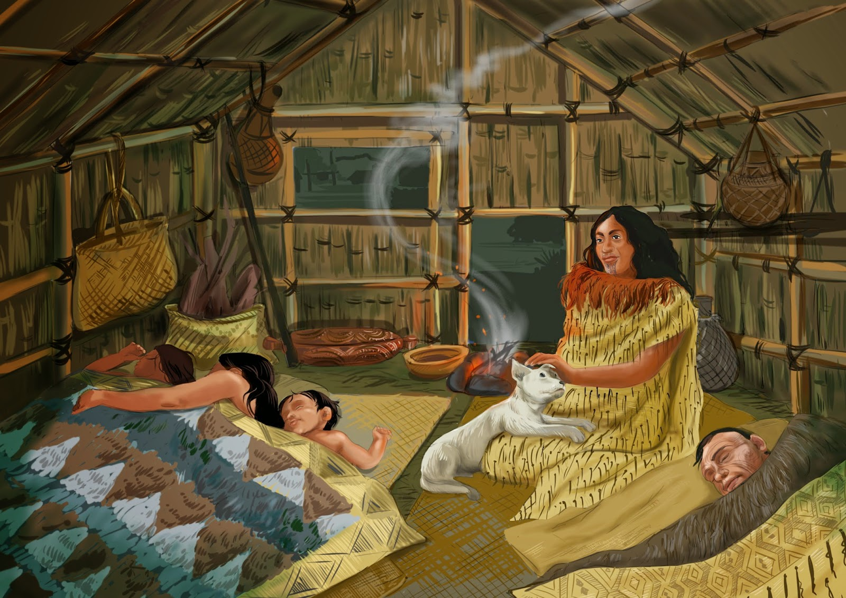
He Kōrero Whakataki - Introduction
Next
Notes:
The size of whare in pā were small unless you were a chief.
Many whare were built partway in the ground to keep warm during winter
They all had a fireplace inside

Slide 6
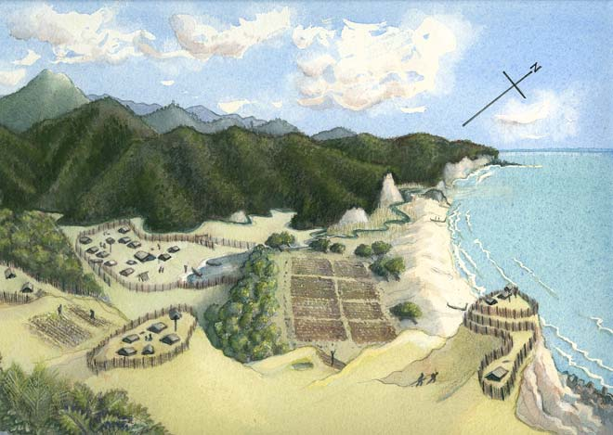
Kaupapa - Purpose
Notes:
By the end of the 18th century, most communities in northern New Zealand maintained at least one pā in a state of readiness.
Some pā were also substantial villages and home to sizable populations. Others functioned more like refuges or fortified food stores. The people would live in a kainga close by, and use their pā for ceremonial reasons or for shelter when an attack was imminent.
Pā were built on hills, forests (some like tree huts), swamps, open land (south Island)

Slide 7
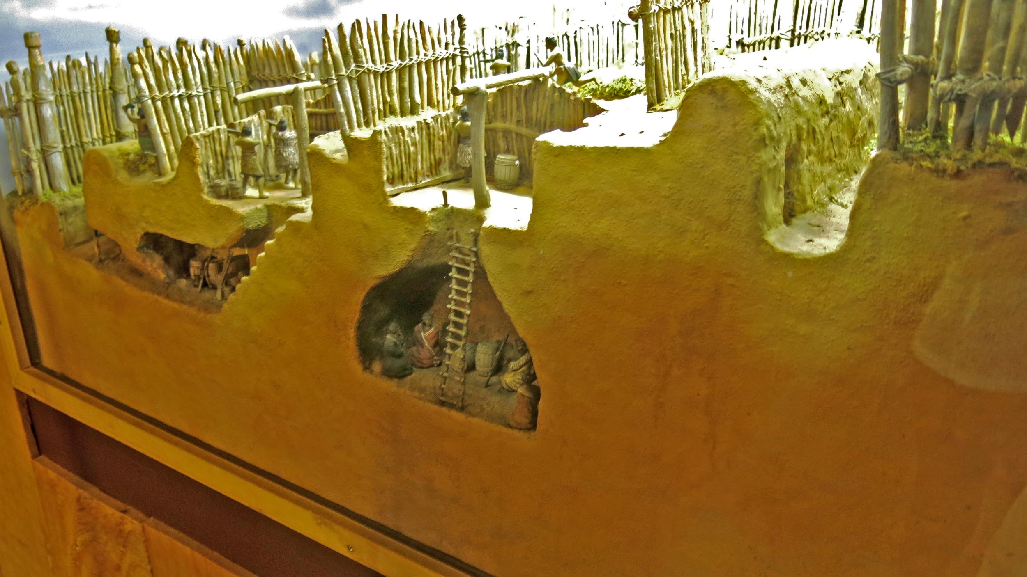
At first I thought success was just the education thing. It is nice to have the grades but success to me is where my son is happy and knows who he is and where he comes from. It is not just about the grade it is about the person as well. Because if you are not really 100% in yourself, knowing who you are as a Maori then the rest doesn’t really matter.
(Tiriwa Marae, whanau member 1)
Notes:
Food Storage 1
Most pā had houses and food storage facilities within the defences. Early European missionaries record pā containing one hundred or two hundred houses, but most pā would have had far less accommodation than that. Some of the so-called “houses” were actually covered food-storage pits. Food, especially kumara (sweet potato), was often stored inside the defences of the pā. There were two reasons for this: to protect the invaluable winter food supply and to provide sustenance in case of a siege

Slide 8
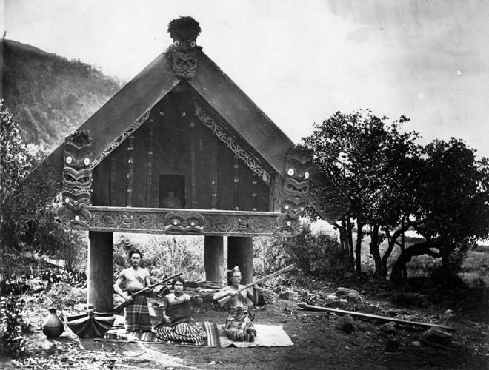
.
Notes:
Pātaka – Maori store houses (seniors, we talked about this last week during kapa haka)
Door size - why so small?
On stilts to protect food from pests and animals

Slide 9
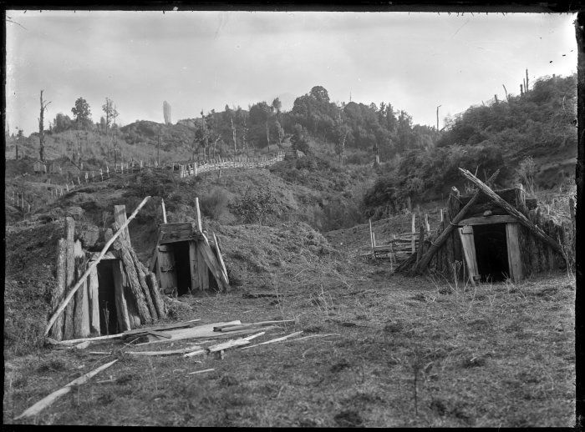
So what does success as Māori look like according to Māori?
Being happy, having a positive Māori identity
A strong sense of belonging to a collective identity
Social confidence in the Maori world and the Pakeha world
Academic and cultural participation
Retention
Notes:
Kumara storage - seniors we talked about this last week during kapa haka and while we were on our hikoi at Mrs Brown’s farm
In the ground

Slide 10
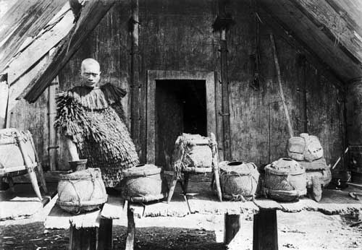
Māori success as Māori vs Successful Māori
Enable Māori to live ‘as Maori’
Enable Māori to actively participate as members of Maori society
contribute meaningfully to its development.
Provide access to a full range of contemporary global knowledges, so that Maori can participate fully as citizens of the world.” (Ka Hikitia p.5)
Notes:
Taha (Maori calabashes made from the fruit of the gourd plant) for holding all types of food

Slide 11
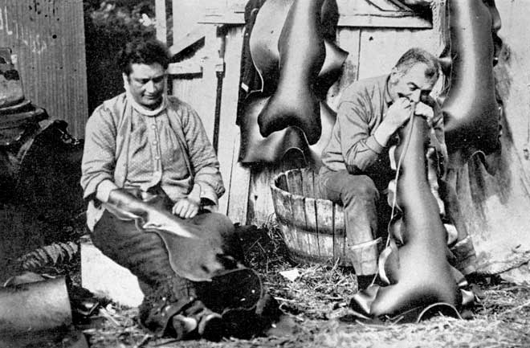
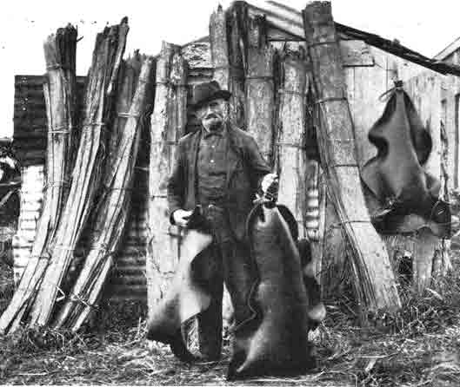
Notes:
Pōhā (bull kelp bags)
The outer skin of rimurapa (bull kelp) is airtight. Air is trapped in the honeycomb-like structure inside each blade. Food preserved inside a pōhā can be kept safely for up to two or three years.
Traditional pōhā (bull kelp bags) are still used today by South Island Māori to preserve many types of food, and to transport preserved food from one area to another.
Making pōhā to store muttonbirds

Slide 12
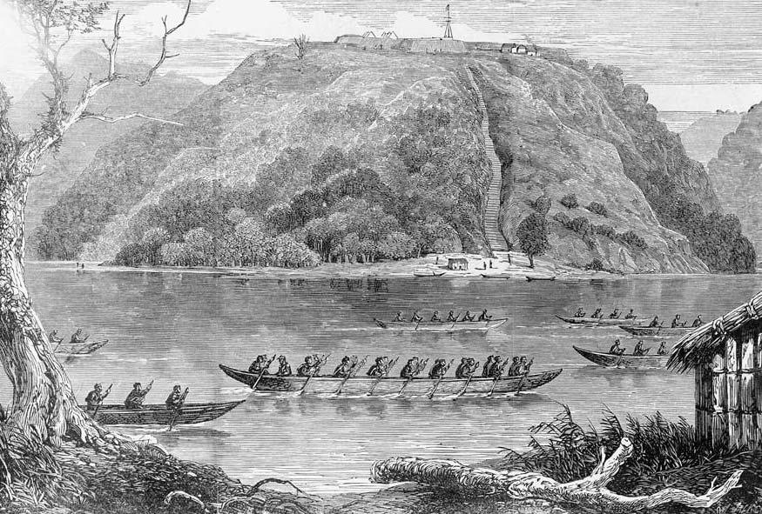
Notes:
The image looks across the river towards a steep hill crowned by the Alexandra Redoubt. Six Māori canoes are on the river and there is a raupō hut in the right foreground. A small hut and figures can be seen on the opposite bank. The redoubt has several buildings behind low walls, and a flagpole on which a flag flies.
The 65th Regiment established the Alexandra Redoubt on a hill above the Waikato River as the invasion of Waikato began in July 1863. It was to be a base for control of the lower reaches of the river and protection of the supply lines of the invasion force.

Slide 13
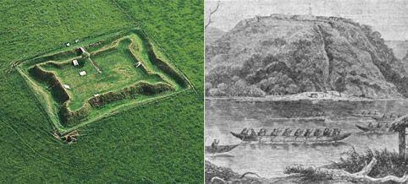
NOW THEN
Notes:
The image looks across the river towards a steep hill crowned by the Alexandra Redoubt. Six Māori canoes are on the river and there is a raupō hut in the right foreground. A small hut and figures can be seen on the opposite bank. The redoubt has several buildings behind low walls, and a flagpole on which a flag flies.
The 65th Regiment established the Alexandra Redoubt on a hill above the Waikato River as the invasion of Waikato began in July 1863. It was to be a base for control of the lower reaches of the river and protection of the supply lines of the invasion force.

Slide 14
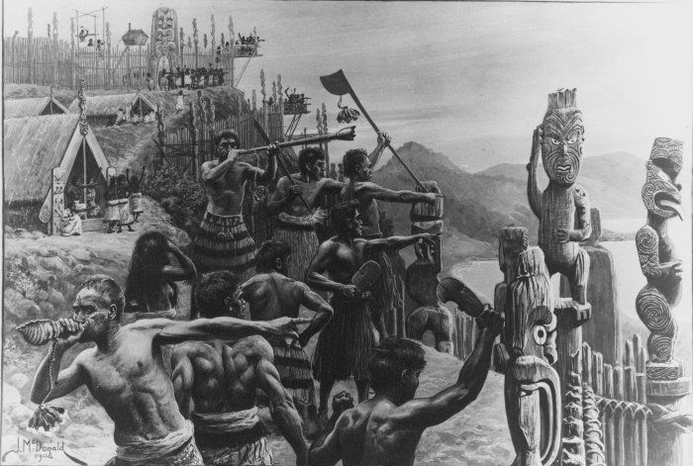
National Priorities:
Maori learners working with others to determine successful learning and educational pathways
Maori learners excel and successfully realise their cultural distinctiveness and potential
Maori learners successfully participating in and contributing to Te Ao Maori
Notes:
Roles
Tāne
were responsible for felling trees, clearing ground for cultivation, planting, trapping birds and rats, digging fern roots, deep-sea fishing, canoe making, carving, stone-working, tattooing. warfare
Especially skilled individuals could become specialists (tohunga ) as carvers, builders, and raft makers. The Maori preferred to work cooperatively,
Wāhine
Were responsible for gathering, weeding, collecting firewood, carrying water, cooking, plaiting, and weaving.
Cooking was done by men and women. Women prepare, men cook
Child rearing women mostly
Seasonal
Activities such as planting, harvesting, hunting birds, fishing and eeling were seasonal.
Tamariki
Mostly related
Only Chiefs children attended school (whare wananga)
Children helped mums and dads in whatever their jobs were
Played a lot of games together
Were considered very special and were hardly ever – if ever reprimanded.

Slide 15
My whānau roles compared to whānau who lived on a Pā
My whānau
Whānau on a Pā
similarities
Notes:
IF TIME - Response activity
Tāne
were responsible for felling trees, clearing ground for cultivation, planting, trapping birds and rats, digging fern roots, deep-sea fishing, canoe making, carving, stone-working, tattooing.
Women were responsible for gathering, weeding, collecting firewood, carrying water, cooking, plaiting, and weaving.
Especially skilled individuals could become specialists (tohunga ) as carvers, builders, and raft makers. The Maori preferred to work cooperatively,
Activities such as planting, harvesting, hunting birds, fishing and eeling were seasonal.
Some tasks, such as rat trapping, canoe building and warfare were largely done by men;
Cooking was done by men and women. Women prepare, men cook
weaving was done by women.
Child rearing women
Tohunga were specialists in areas such as carving, tattooing, medicine, building and spiritual matters.
Chiefs children attended school (whare wananga)
Children helped mums and dads. Were considered very special and were hardly ever – if ever reprimanded.

