Slide 1
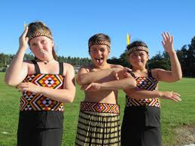
Waipipi Kapa Haka
E Minaka Ana
https://www.youtube.com/watch?v=IBsU1l3y0DM

Slide 2
Kia kaha tātou ki te (HI!)
Kōrero Māori
Let’s be staunch in speaking te reo Māori

Slide 3
E minaka ana
E minaka ana taku waha Ki te kai a te rangatira,
Taku reo rangatira
Taku reo rangatira Taku kuru pounamu tuku iho
my talk be like that of a leader, my noble language my precious inheritance

Slide 4
Mīharo kē ana
Mīharo kē ana Ki tōna pakari kia ora
Tē memeha
Tē memeha, te wairua ki te kōrero Māori
Astound me with your maturity by the evanescence, the spirit you show when speaking Maori.

Slide 5
E minaka ana
E minaka ana taku waha Ki te kai a te rangatira,
Taku reo rangatira
Taku reo rangatira Taku kuru pounamu tuku iho
my talk be like that of a leader, my noble language my precious inheritance

Slide 6
Mīharo kē ana
Mīharo kē ana Ki tōna pakari kia ora
Tē memeha
Tē memeha, te wairua ki te kōrero Māori
Astound me with your maturity by the evanescence, the spirit you show when speaking Maori.

Slide 7
Kia kaha tātou Ki te (HI) kōrero Māori!
Let us be staunch in speaking Maori!

